Slide 1
CloudLens
CAPSTONE PROJECT · VIVA
DevOps dashboard for resource and cost monitoring across AWS, Azure and GCP
AWS
Azure
GCP
FastAPI · PostgreSQL · React · Prometheus · Docker
[Student name] · [Roll no.] · [Institute] · October 2026
Notes:
Good morning. I’m presenting CloudLens, a centralised dashboard that brings cost and utilisation data from AWS, Azure and GCP into one place, analyses it, and alerts the team on Slack or Teams when something goes wrong.

Slide 2
Three clouds, three consoles, no single picture
PROBLEM STATEMENT
Fragmented data
Late surprises
Hidden waste
Each provider names services, tags and regions differently, so costs can’t be compared directly.
Runaway jobs and budget overruns are noticed on the invoice, weeks after the money is spent.
Idle and over-provisioned resources keep billing because nobody links cost to utilisation.
Goal: one centralised dashboard that aggregates all three clouds, tracks utilisation and cost trends, sets thresholds and alerts on anomalies.
CloudLens · Capstone viva · 2
Notes:
DevOps teams on several clouds face three issues: the data is fragmented, problems are discovered late, and waste stays hidden because cost isn’t linked to utilisation. The project brief asks for one dashboard that solves all three.

Slide 3
Four goals, all delivered
PROJECT GOALS
01
02
Aggregate AWS, Azure and GCP
Real-time and historical views
Three connectors plus a mock mode, one unified schema
5-minute utilisation, trends, month-over-month, anomalies
03
04
Customisable alerting
Filters and drill-down
8 rule types via Prometheus Alertmanager to Slack and Teams
Provider, environment, resource type, date range, per resource
CloudLens · Capstone viva · 3
Notes:
These are the four goals from the brief. Each one maps to a working feature I’ll show in the demo.

Slide 4
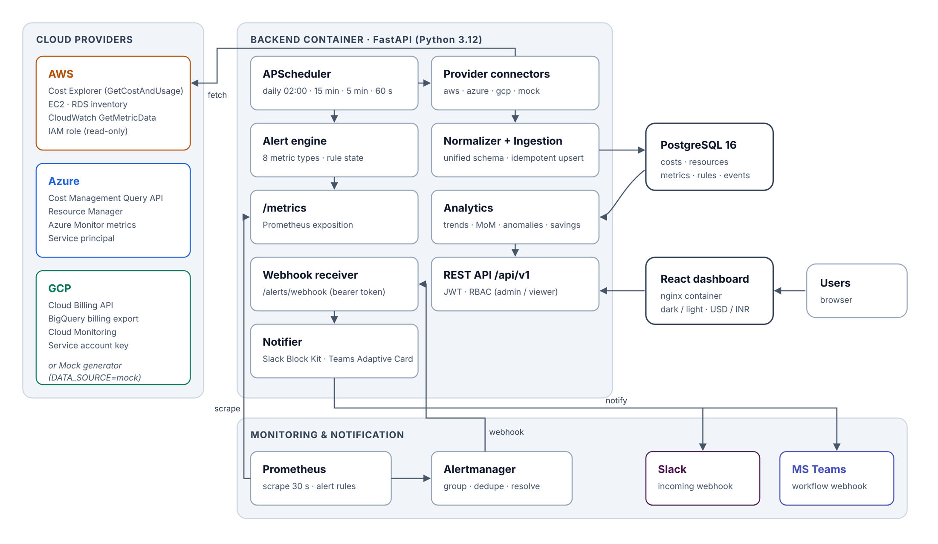
Six containers, one Docker Compose file
ARCHITECTURE
CloudLens · Capstone viva · 4
Notes:
The backend container holds the scheduler, connectors, ingestion, analytics, alert engine and the REST API. PostgreSQL stores history. The React app is served by nginx. Prometheus scrapes the backend’s metrics, Alertmanager routes alerts back to a webhook, and the notifier posts to Slack and Teams.

Slide 5
Each tool chosen for a reason
TECHNOLOGY CHOICES
Layer | Choice | Why
Database | PostgreSQL 16 | Relational cost data, idempotent upserts, indexed GROUP BY
Backend | Python FastAPI | Validation, OpenAPI docs, async-capable
Scheduling | APScheduler | In-process jobs, no extra broker to run or pay for
Frontend | React + Recharts | Filters, drill-down, RBAC, dark/light, USD/INR
Alerting | Prometheus + Alertmanager | Industry standard grouping, dedupe, resolve
Packaging | Docker Compose → EC2 | Same stack on a laptop and in staging
CloudLens · Capstone viva · 5
Notes:
PostgreSQL rather than MongoDB, because cost data is tabular: provider by account by day by service. Unique constraints make every sync idempotent, and composite indexes keep trend queries fast.

Slide 6
One schema for every cloud
DATA AGGREGATION
Field | AWS Cost Explorer | Azure Cost Mgmt | GCP billing export
day | TimePeriod.Start | UsageDate | usage_start_time
service | SERVICE | ServiceName | service.description
environment | environment$prod | tag value | label value
cost (USD) | UnblendedCost | Cost, INR → USD | cost + credits
Normaliser maps services to 6 types, tags to 4 environments
Idempotent upsert on the natural key: re-runs never duplicate
Scheduled: daily 02:00, cost 15 min, metrics 5 min
CloudLens · Capstone viva · 6
Notes:
The key design decision: one grain for every provider, which is provider, account, day, service, environment, region and resource. Note that GCP’s Cloud Billing API does not return daily cost lines, so we read the BigQuery billing export, which is Google’s supported source. A DATA_SOURCE switch in .env flips between the mock generator and live APIs.

Slide 7
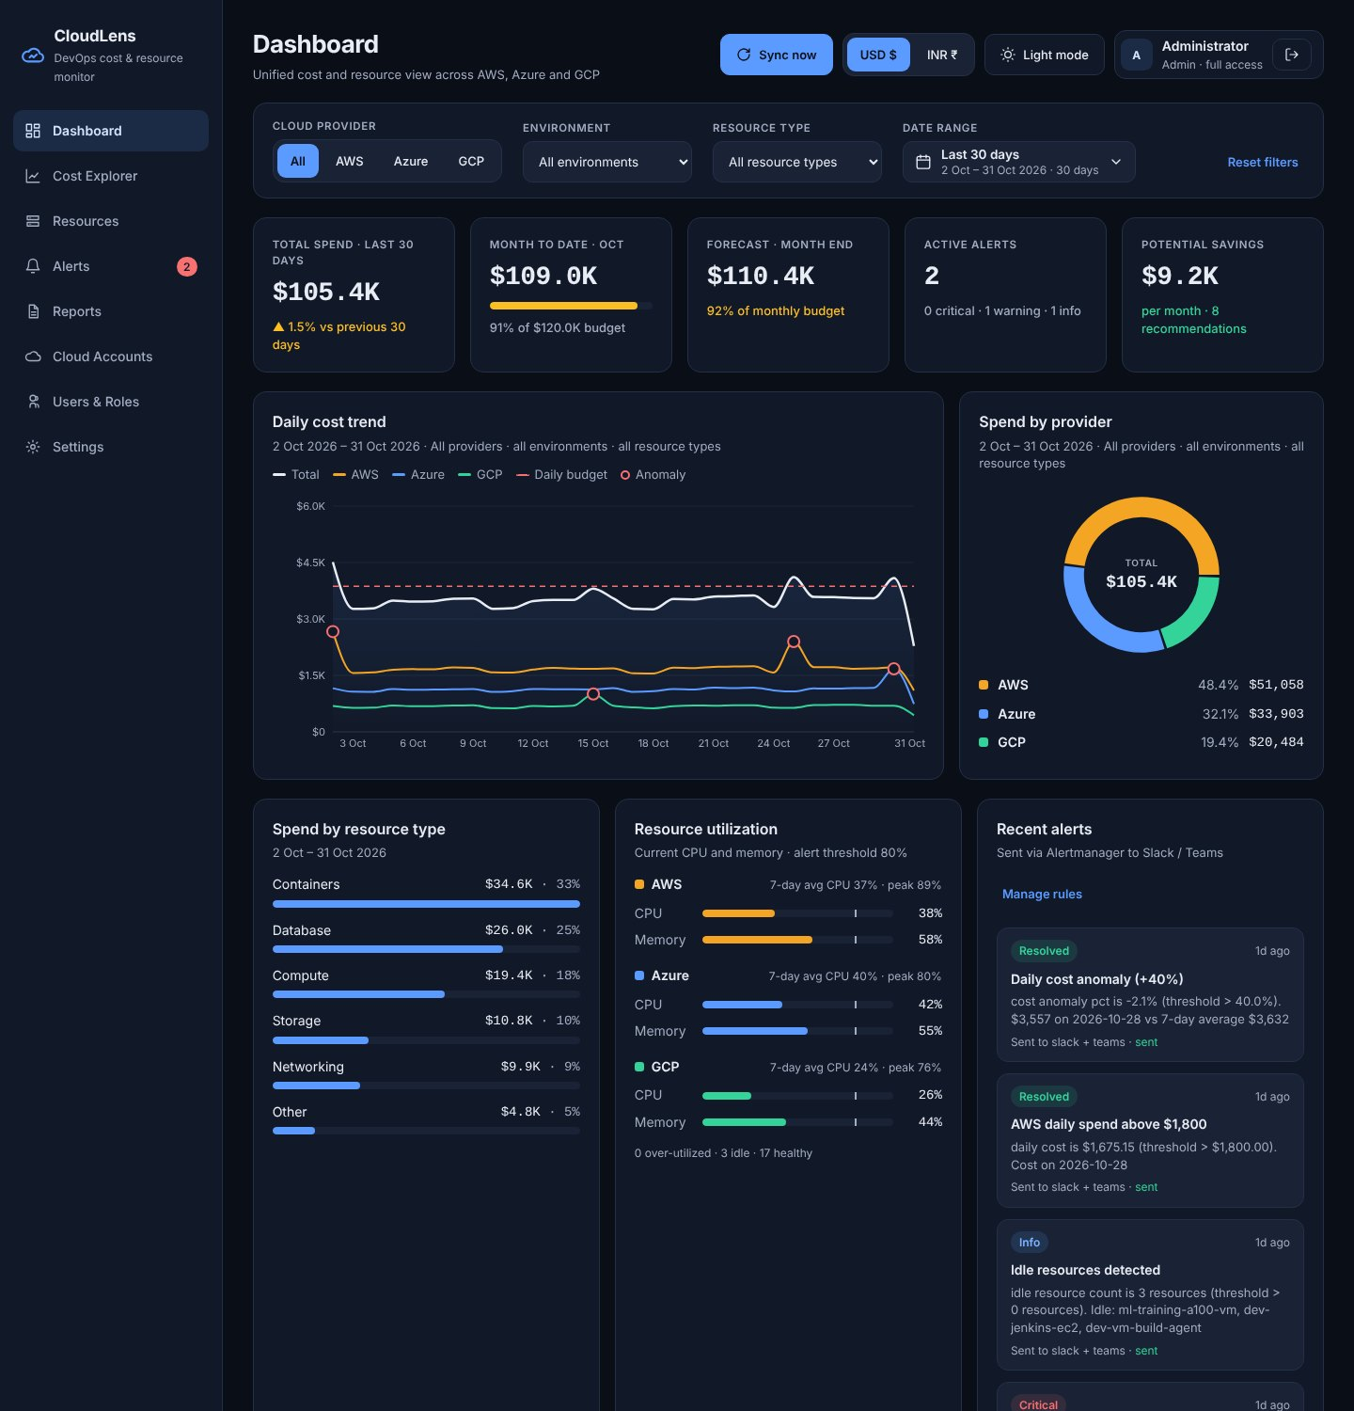
Everything on one screen
REAL-TIME DASHBOARD
KPIs: spend, MTD vs budget, forecast, alerts, savings
Trend with budget line and anomaly markers
Utilisation per cloud, 80% threshold
Date-range calendar shared by every screen
Auto-refresh every 60 s
CloudLens · Capstone viva · 7
Notes:
This is the screen approved at the design stage. Filters for provider, environment, resource type and date range sit at the top and are shared with the other screens. Theme and currency toggles are in the header.

Slide 8
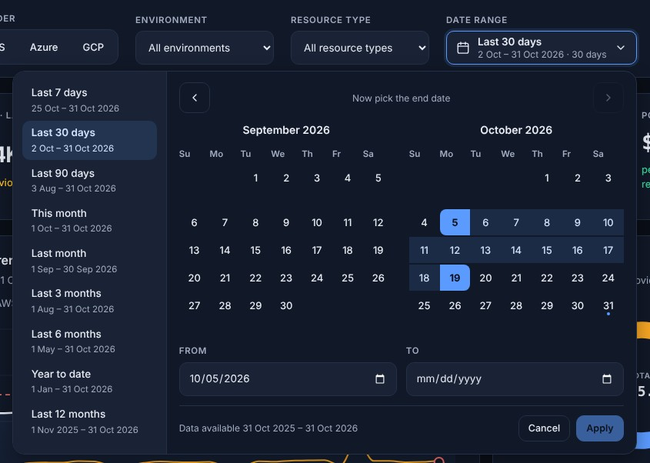
Any period, validated
HISTORICAL ANALYSIS
Presets from today: 7–90 days, months, YTD
Custom range: click start, click end, Apply
No future dates; start ≤ end; ≤ 731 days
Month-over-month with run-rate for partial months
Reports for any range, e.g. last 6 months, CSV
CloudLens · Capstone viva · 8
Notes:
Every screen shares one date-range picker. Presets are computed from the server’s today, so nothing is hard-coded. Future days are disabled, and the API rejects future, reversed or over-long ranges with a readable 422 as well. A partial month is compared on daily run rate rather than total.

Slide 9
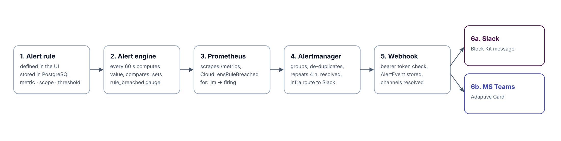
Rules in the UI, delivery by Prometheus
ALERTING PIPELINE
One gauge per rule: cloudlens_alert_rule_breached
Grouping, dedupe, 4 h repeat, resolved messages
Webhook protected by a bearer token
CloudLens · Capstone viva · 9
Notes:
Users never edit Prometheus files. The engine evaluates each rule every minute and exports one gauge per rule; a single Prometheus rule turns breached gauges into alerts. Alertmanager handles grouping, repeats and resolved notifications, and calls our webhook, which posts to Slack and Teams. If the backend itself is down, that alert goes straight to Slack.

Slide 10
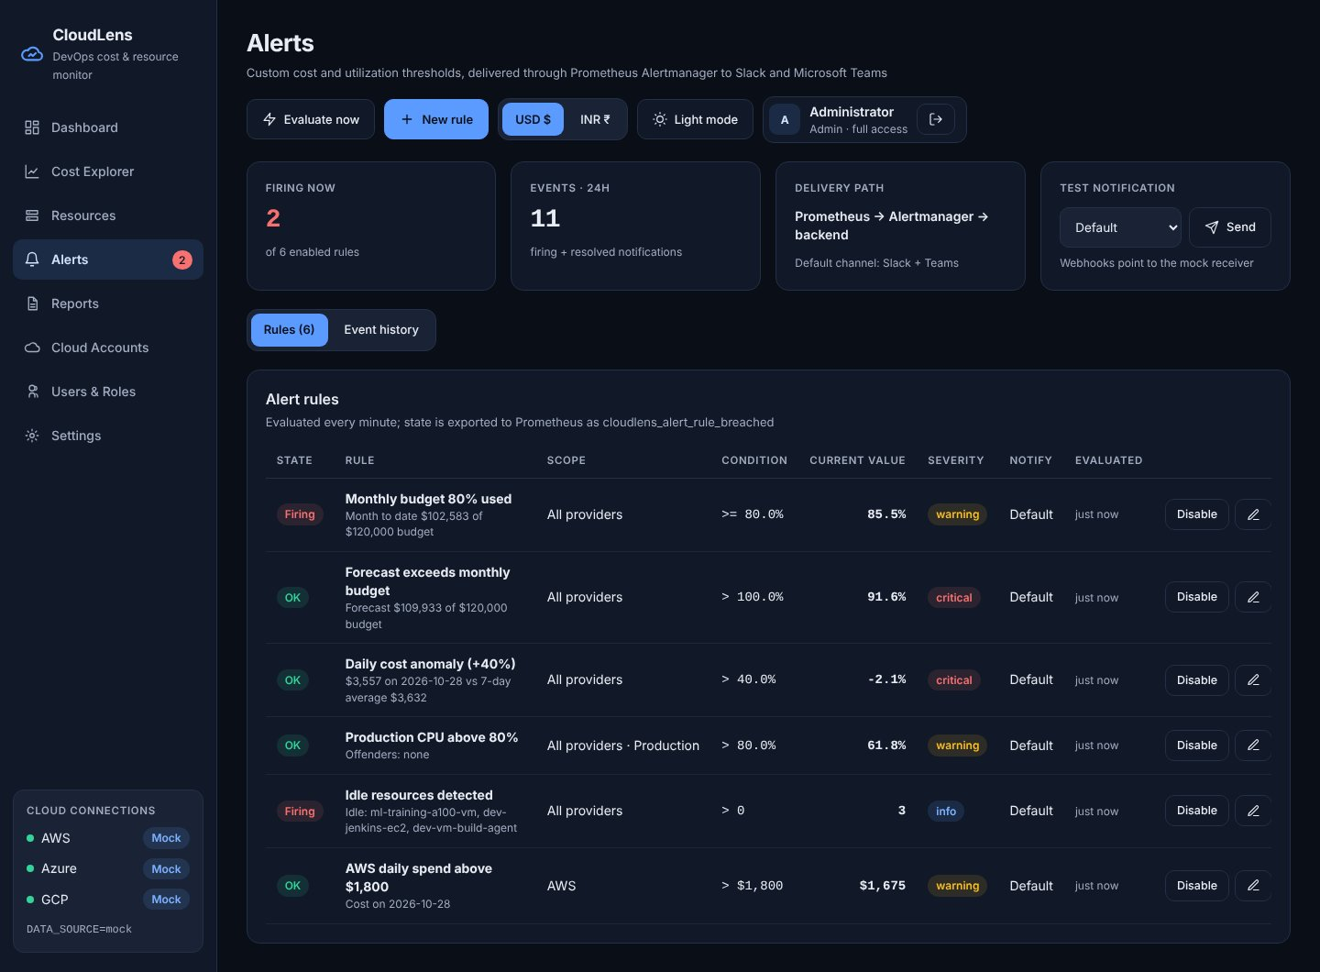
8 rule types, any scope
CUSTOMISABLE ALERTS
Watch | Example
Daily cost | AWS > $1,800
Budget used % | ≥ 80% warning
Forecast % | > 100% critical
Cost anomaly % | > 40% critical
CPU / memory | Prod CPU > 80%
Idle resources | count > 0
CloudLens · Capstone viva · 10
Notes:
Each rule picks a metric, an operator and threshold, an optional provider, environment or type scope, a severity, and a channel: Slack, Teams, both, or the default from Settings. A new rule is evaluated immediately so you see its state at once. Viewers can see rules but not change them.

Slide 11
Monitoring that pays for itself
COST OPTIMISATION
$9.2K
$0.60
~$21
monthly savings found on demo data (about 8.5% of spend)
per month in Cost Explorer calls: 3-day lookback, calls counted per sync
per month to run the whole stack on one t3.small
Recommendations: stop idle, rightsize, off-hours schedules, storage tiering. Plus budget forecasts, anomaly alerts, retention policies and partition-filtered BigQuery queries.
CloudLens · Capstone viva · 11
Notes:
Cost optimisation is ten percent of the marks, so two angles. For the clouds we monitor: the recommendations engine compares each resource’s 30-day cost with its 7-day utilisation. On the demo data the biggest item is an idle GPU training VM. For our own platform: Cost Explorer charges a cent per request, so we never poll it every minute; the daily sync re-reads three days and every run records its API calls. The whole stack runs on one small instance for about 21 dollars a month.

Slide 12
Verified at every layer
TESTING
84
85%
31
8
backend tests pass on SQLite and PostgreSQL
line coverage, analytics 97%
frontend unit tests, incl. date picker
Slack + Teams messages in the end-to-end run
Breakdowns always sum to the period total; re-syncs never change row counts
Future, reversed and > 731-day ranges rejected (HTTP 422)
Real Prometheus + Alertmanager: fire, deliver, resolve
Every screen captured in both themes and at phone width
CloudLens · Capstone viva · 12
Notes:
Beyond unit tests we ran the real Prometheus 2.55 and Alertmanager 0.27 binaries against the backend. Injecting a spike fired four rules and delivered eight messages; clearing it produced resolved messages. The pinned requirements were also tested in a clean virtual environment.

Slide 13
Laptop to EC2 staging in three commands
DEPLOYMENT
t3.small, IMDSv2, 20 GB gp3, swap
IAM instance role, read-only policy
Only port 80 public; SSH from your IP
Non-root containers, health checks, log rotation
Backups, hardening checklist
$ cp .env.example .env.staging
$ KEY_NAME=my-key ./deploy/aws/create-ec2.sh
$ EC2_HOST=<ip> ./deploy/aws/deploy.sh
Healthy. Open http://<ip>/
CloudLens · Capstone viva · 13
Notes:
The same docker-compose file runs locally and on EC2. The create script makes the security group, an IAM role with a read-only Cost Explorer, EC2, RDS and CloudWatch policy, and the instance. The deploy script syncs the code, uploads the staging env file, builds and waits for the health check. Prometheus and Alertmanager stay on localhost and are reached through an SSH tunnel.

Slide 14
Five minutes, end to end
LIVE DEMO
# | Show | Point to make
1 | Dashboard, filter AWS → Production | One view, every widget follows the filter
2 | Toggle INR and light mode | Lakh / crore units; theme persists
3 | Click a resource | Drill-down: cost bars, CPU, recommendation
4 | Date picker → Last 6 months; type a future date | Presets from today; validation blocks future / reversed ranges
5 | Inject an AWS spike, wait ~90 s | Prometheus fires; Slack + Teams in mock inbox
6 | Sign in as viewer | Admin actions hidden and blocked by the API
CloudLens · Capstone viva · 14
Notes:
Before the viva: docker compose up, open the dashboard, the mock inbox at /mock-inbox/ and Prometheus alerts in separate tabs. For step 5 use Cloud Accounts, AWS, times 2.5, one day ago. Clear the spike afterwards to show resolved messages.

Slide 15
What we learned, and what’s next
CONCLUSION
Learnings
Future scope
Each cloud exposes cost differently; a unified contract hides it
Idempotent upserts make scheduled jobs safe to re-run
Paid APIs need cost-aware design and call accounting
Keep users in the UI, keep alert delivery standard
Alembic migrations, HTTPS, live exchange rate
Separate worker; TimescaleDB for metrics
ML forecasting, per-service anomalies
SSO, audit log, scheduled email reports
CloudLens · Capstone viva · 15
Notes:
To summarise: all four goals are met, the system is tested end to end, and it is cheap to run. The roadmap starts with migrations and HTTPS before any production use.

Slide 16
Thank you
Questions?
docs/ · report · 15 module docs · 10 screen docs
/docs → live API reference
[Student name] · [Roll no.] · [Institute]
Notes:
Likely questions: why PostgreSQL over MongoDB; why not Grafana; how GCP costs are fetched without a cost API; how duplicate alerts are avoided; what happens when a provider’s credentials are missing (that provider is skipped, the others continue).

